Slide 1
TEAM - 4
ELEVATOR SYSTEM DESIGN
RAMACHANDRAN.R
JEGAJEETH.M
KHAASHWINI.M.S
POOVIGA.S

Slide 2
PROBLEM DEFINITION :
The software of the elevator controller is responsible for the safe and efficient operation of all of the other components within the elevator system. The controller’s main goal is essentially to handle input signals from other components and respond accordingly with output signals.

Slide 3
FEATURES INCLUDE :
Login and Sign up page is created for storing Building Details.
Before a person enters a lift , it checks if a person belongs to the respective building.
Fetching the number of floors from Api and changing it dynamically.
Basic lift animations using Angular and CSS.
New Person can be added according to the maximum capacity of elevator else Alert message will be shown as “Reached Maximum Capacity”.
Power status and Generator status will be checked.
Lift can be moved either by pressing buttons inside or outside the lift.
If we hover the person inside the lift , weight of the person will be shown.

Slide 4



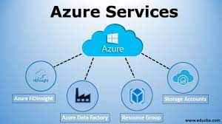
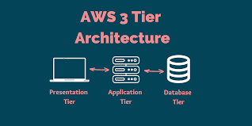
TECHNOLOGIES USED :
API
STANDARDS

Slide 5
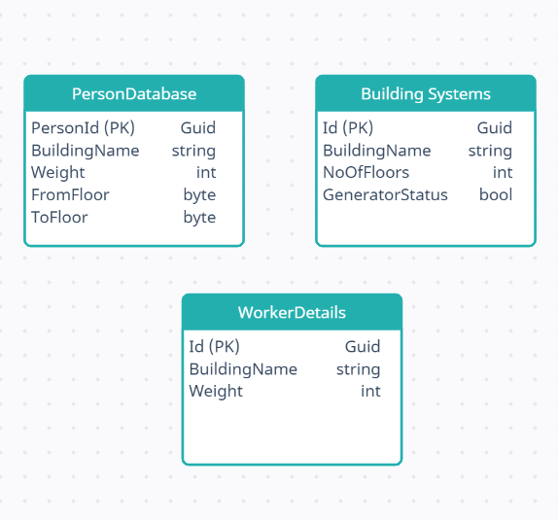
DATABASE USED

Slide 6
ASSUMPTIONS
We have planned to build real-time lift where each person can go to different floors accordingly.
Planned to turn on music , fan, light whenever the lift is in operation.
Whenever power goes off, generator gets on automatically and lands on the next floor.

Slide 7

UNIQUENESS
There’s a SignIn and SignUp page for Buildings
In SignIn page , based on the building name the number of floors will be fetched and the floors of the lift will change accordingly.
Each person can only enter to their respective building , They are allowed only if their id is present in the building details database.

Slide 8

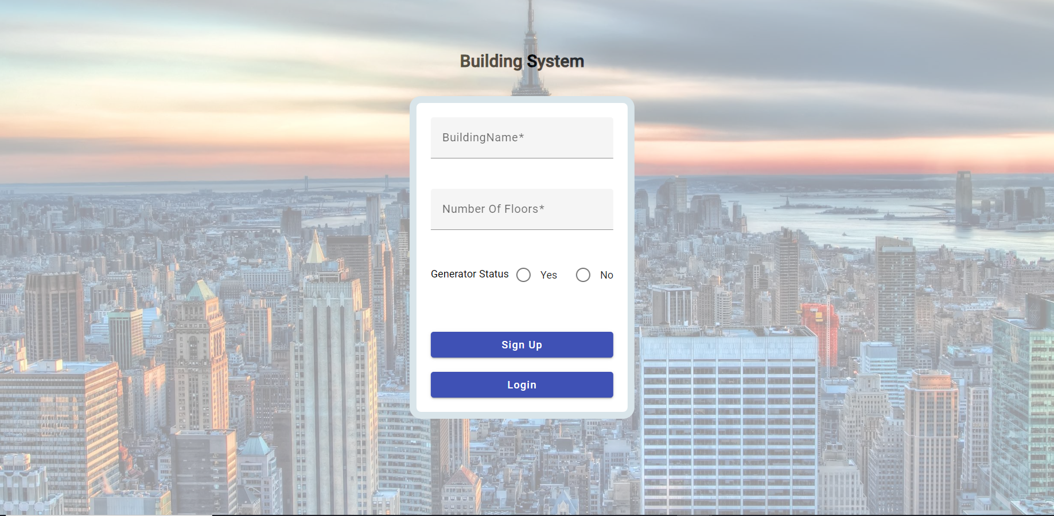
1) Sign Up Page
OUTPUT SCREENSHOT

Slide 9
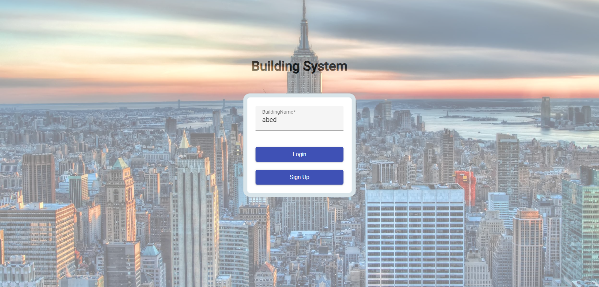
2) Sign In Page
OUTPUT SCREENSHOT

Slide 10
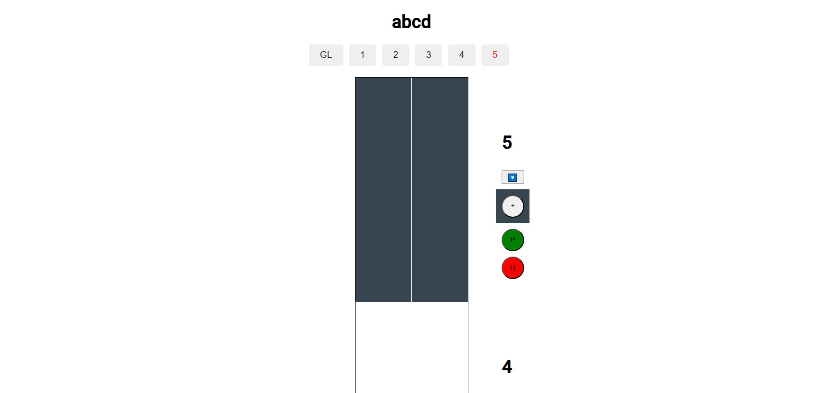
WHEN THE LIFT IS CLOSED

Slide 11
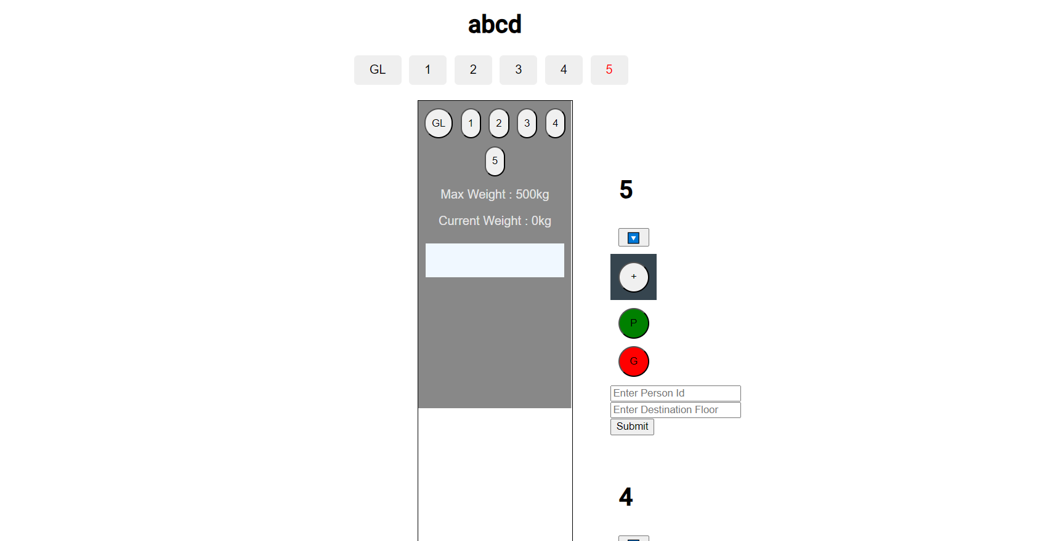
WHEN THE LIFT IS OPEN

Slide 12
STANDARD FOLLOWED
Validation
Handled errors
Followed separation of Concerns
Reusability of Codes
API Standards

Slide 13
THANK YOU

